Slide 1
Branch and Bound
CSE 1205: Object Oriented Programming
Md Mehrab Hossain Opi

Slide 2
The Method
All state space search methods in which all children of the E-node are generated before any other live node can become the E-node.
Both BFS and D-search can be generalized to branch and bound strategies.
BFS will be called FIFO search.
D-search will be called LIFO search.
Bounding functions are used to help avoid the generation.

Slide 3
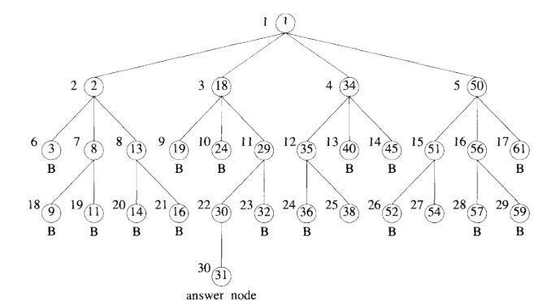
Least Cost (LC) Search
In both FIFO and LIFO- BB the selection rule for the next E-node is rigid and blind.
The rule does not give preference to a node that has a very good chance of getting the search to an answer node quickly.
Node 30 could
be explored first

Slide 4
Least Cost (LC) Search
The search for an answer node can often be speeded by using an “intelligent” ranking function.
The next E-node is selected on the basis of this ranking function.
The ideal way to assign ranks would be on the basis of the additional computational effort
Needed to reach an answer node from the live node.

Slide 5
Least Cost (LC) Search
For any node x, this cost could be
The number of nodes the subtree x that need to be generated before an answer node is generated.
The number of levels the nearest answer node ( in the subtree x) is from x.

Slide 6
Problem of Ideal Cost Function
Computing the cost of a node usually involves a search of the subtree x for an answer node.
By the time the cost of a node is determined, that subtree has been searched
no need to explore again.
Instead of using ideal function we will rank by estimated cost.

Slide 7
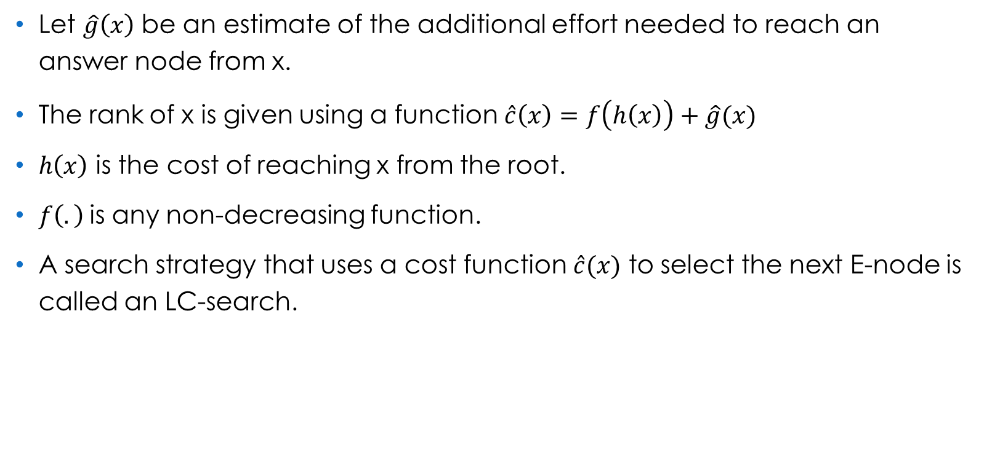
Least Cost (LC) Search

Slide 8
Example – The 15-puzzle
The puzzle consists of 15 numbered tiles on a square frame with a capacity of 16 tiles.
We are given an initial arrangement of the tiles, and the objective is to transform this arrangement into the goal arrangement.
Using legal moves only.
1 | 3 | 5 | 2
13 |  | 6 | 4
14 | 9 | 8 | 7
15 | 10 | 11 | 12
1 | 2 | 3 | 4
5 | 6 | 7 | 8
9 | 10 | 11 | 12
13 | 14 | 15

Slide 9
Example – The 15-puzzle
The only legal moves are one in which a tile adjacent to the empty spot is moved to the empty spot.
1 | 3 | 5 | 2
13 |  | 6 | 4
14 | 9 | 8 | 7
15 | 10 | 11 | 12
1 |  | 5 | 2
13 | 3 | 6 | 4
14 | 9 | 8 | 7
15 | 10 | 11 | 12
1 | 3 | 5 | 2
 | 13 | 6 | 4
14 | 9 | 8 | 7
15 | 10 | 11 | 12
1 | 3 | 5 | 2
13 | 9 | 6 | 4
14 |  | 8 | 7
15 | 10 | 11 | 12
1 | 3 | 5 | 2
13 | 6 |  | 4
14 | 9 | 8 | 7
15 | 10 | 11 | 12

Slide 10
Example – The 15-puzzle
Each move creates a new arrangement of the tiles.
Arrangements are called the states of the puzzle.
A state is reachable from the initial state iff there is a sequence of legal moves from the initial state to this state.
The state space of an initial state consists of all states that are reachable.

Slide 11
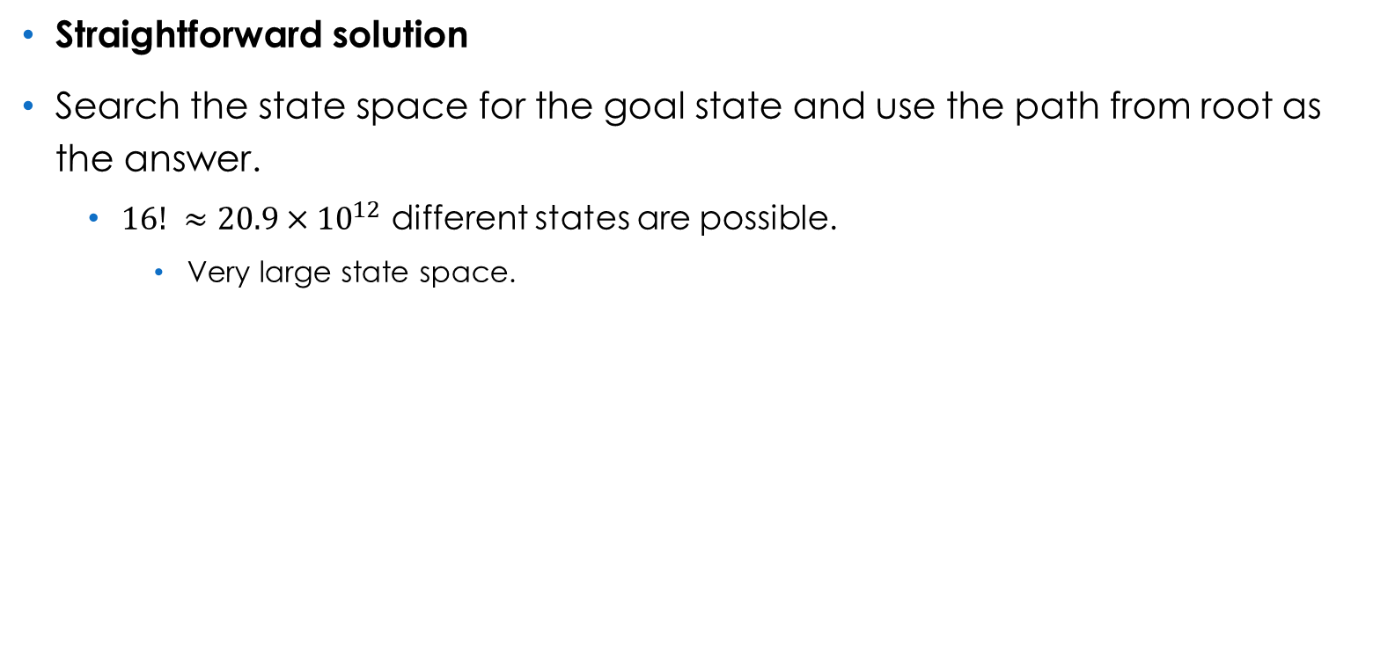
Example – The 15-puzzle

Slide 12
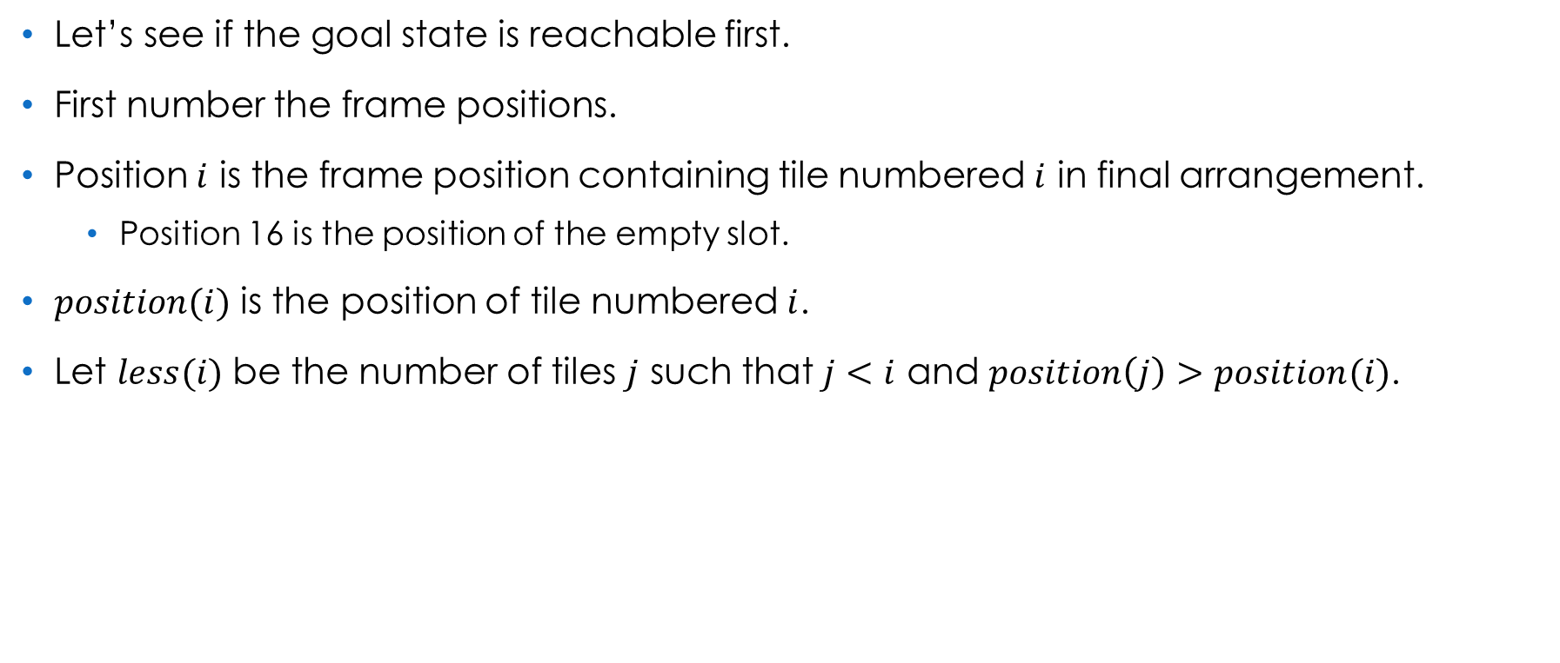

Example – The 15-puzzle
1 |  | 5 | 2
13 | 3 | 6 | 4
14 | 9 | 8 | 7
15 | 10 | 11 | 12

Slide 13
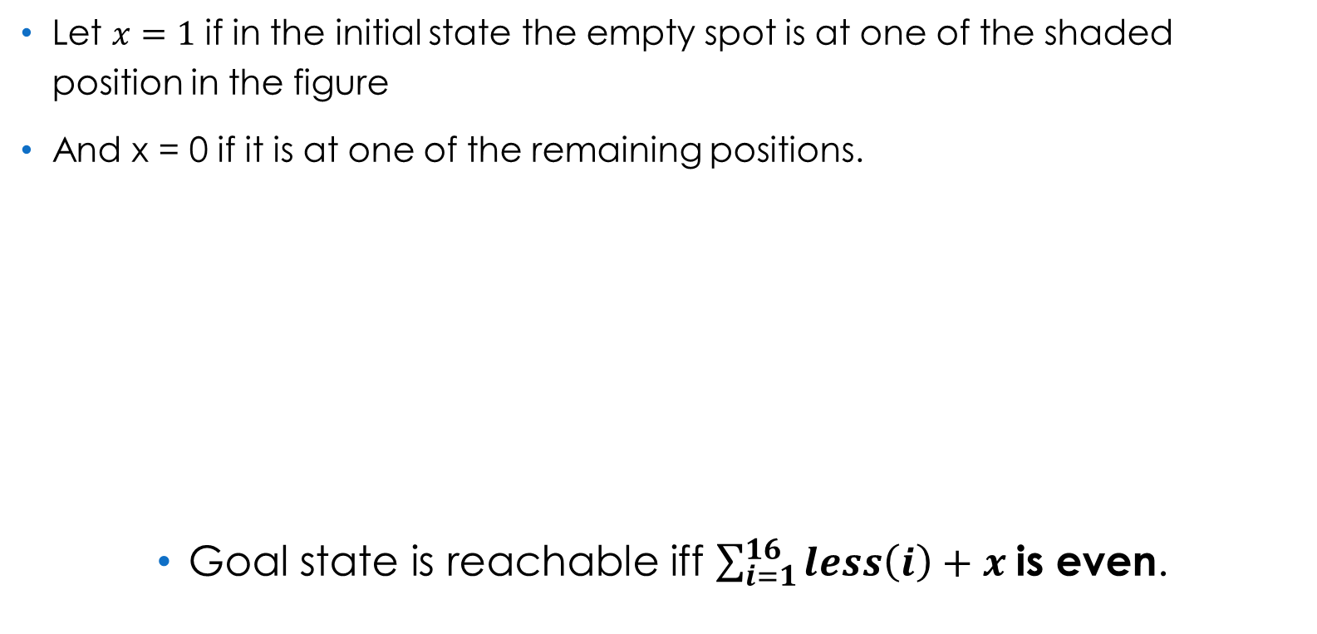
Example – The 15-puzzle
0 | 1 | 0 | 1
1 | 0 | 1 | 0
0 | 1 | 0 | 1
1 | 0 | 1 | 0

Slide 14
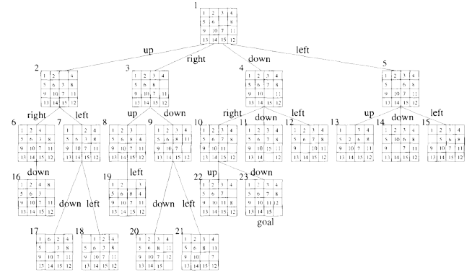
Example – The 15-puzzle
We can organize the state space into a tree.

Slide 15
Example – The 15-puzzle
An answer node may never be found using a depth first search.
A BFS will always find a goal state nearest to the root.
However, such a search is also blind.
Let’s apply an intelligent search.

Slide 16
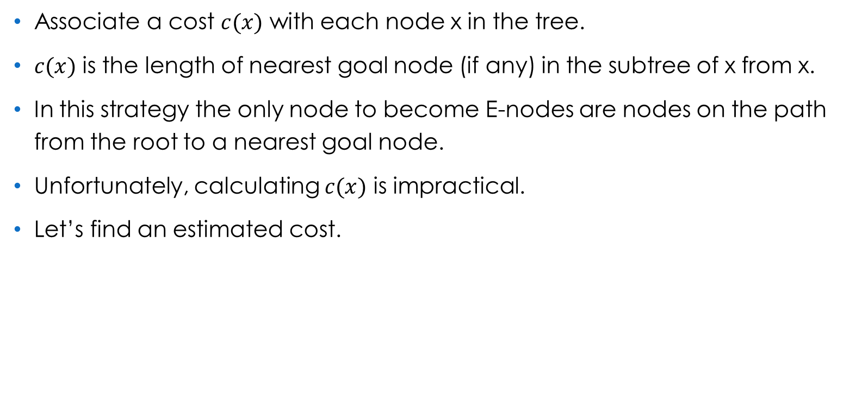
Example – The 15-puzzle

Slide 17
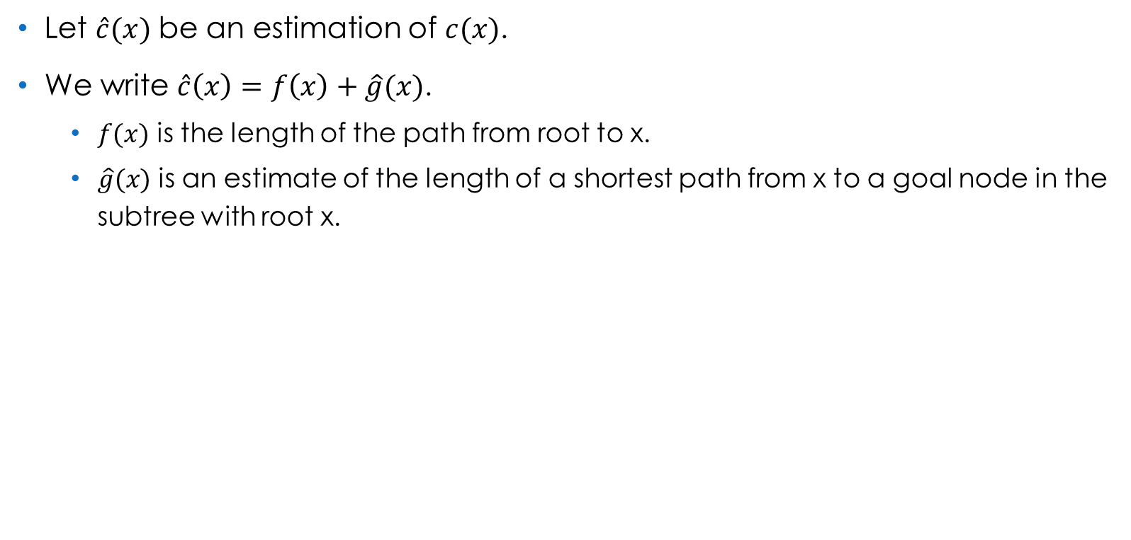
Example – The 15-puzzle

Slide 18
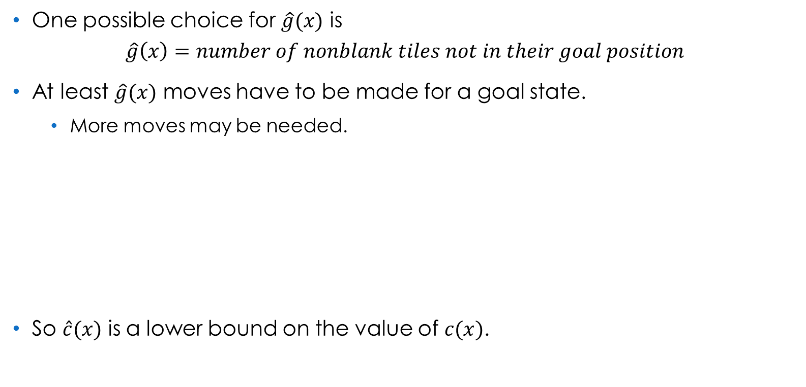
Example – The 15-puzzle
1 | 2 | 3 | 4
5 | 6 |  | 8
9 | 10 | 11 | 12
13 | 14 | 15 | 7

Slide 19
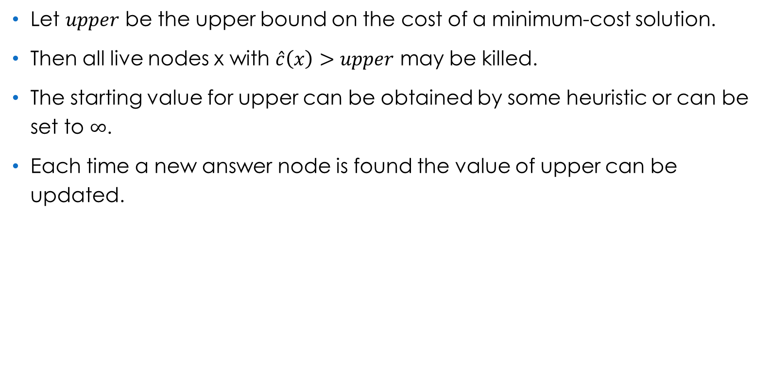
Bounding

Slide 21
References
Computer Algorithms
– Ellis Horowitz, Sartaj Sahni, Sanguthevar Rajasekaran.

Slide 22
Thank You.

